Slide 1
CANDIDA VAGINITIS (MONILIASIS)
Dr Shanthi Serene Sylum V
Professor and Head
Dept. Obstetrics and Gynaecology
SKHMC Kulasekharam

Slide 2
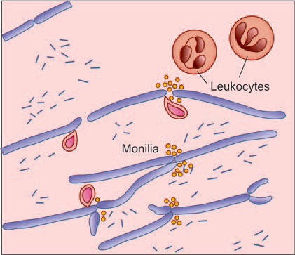
Causative Organism
Moniliasis is caused by Candida albicans, a gram positive yeast-like fungus

Slide 3
 | Predisposing factors for Candida vaginitis
 | . Diabetes : • ↑ Glycogen in the cells, glycosuria . Pregnancy : • ↑ Vaginal acidity, glycosuria • ↑ Glycogen in the cells . Broad spectrum antibiotics : • ↓ Acid forming lactobacillus . Combined oral pills . Immuno suppression – HIV . Drugs–steroids . Thyroid, Parathyroid disease: • Obesity

Slide 4
Clinical Features
The patient complains of vaginal discharge with
intense vulvovaginal pruritus.
The pruritis is out of proportion to the discharge.
There may be dyspareunia due to local soreness.

Slide 5
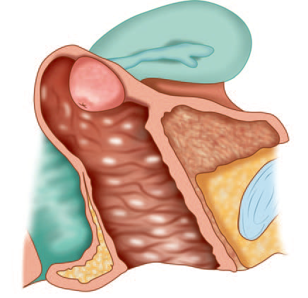
On examination:
(a) The discharge is thick, curdy white and in flakes,
(cottage cheese type) often adherent to the vaginal
Wall.
(b) Vulva may be red and swollen with evidences of
pruritus.
(c) Vaginal examination may be tender. Removal of
the white flakes reveals multiple oozing spots.

Slide 6
Diagnosis:
Wet Smear of vaginal discharge is prepared.
KOH solution (10%) is added to lyse the other cells. Filamentous form of mycella, pseudohyphae
can be seen under the microscope.
Culture in Nickerson’s or Sabouraud’s media—
become positive in 24–72 hours.
Women with recurrent vulvovaginitis, vaginal
boric acid capsule (600 mg gelatin capusles) is
effective. Boric acid inhibits fungal cell wall growth.

Slide 7
Treatment:
Corrections of the predisposing factors should be done, if possible.
Homoeopathic medicines are given with symptom similarity.
Local fungicidal preparations commonly used are of the polyene or azole group. Nystatin, clotrimazole, miconazole, econazole are used in the form of either vaginal cream or pessary.
One pessary is to be introduced high in the vagina at bedtime for consecutive 2 weeks.
In severe cases, additional use of pessary in the morning is advocated.
The treatment should be continued even during menstruation.
Single dose oral therapy with fluconazole (150 mg) or itraconazole is also found effective.

Slide 8
Associated intestinal moniliasis should be treated
by fluconazole 50 mg daily orally for 7 days. Husband
should be treated with nystatin ointment
locally for few days following each act of coitus.
The use of condom is preferred.
Resistance to these drugs is not known. The
systemic antifungal drugs fluconazole and itraconazole are effective in a single dose oral therapy.

Slide 9
DC Dutta’s Textbook of Gynecology including Contraception Enlarged & Revised Reprint of Sixth Edition Edited by Hiralal Conar November 2013 JAYPEE.

Slide 10
Thank you

